Slide 1
SALARY AND COMPENSATION ANALYSIS THOUGH DATA MODELING
STUDENT NAME: SATHISH.S
REGISTER NO: 312214547/AE424C2827C53F3B40749F8636E83600
DEPARTMENT: B.COM ( COMPUTER APPLICATION )
COLLEGE: ST THOMAS COLLEGE OF ARTS AND SCIENCE

Slide 2
PROJECT TITLE
SALARY AND COMPENSATION ANALYSIS THOUGH EXCEL DATA MODELING

Slide 3


AGENDA
Problem Statement
Project Overview
End Users
Our Solution and Proposition
Dataset Description
Modelling Approach
Results and Discussion
Conclusion
3/21/2024 Annual Review

Slide 4

PROBLEM STATEMENT
Salary Distribution: What is the current distribution of salaries across different departments and job roles
Compensation Equity: Are there any noticeable disparities in compensation based on factors such as gender, experience, or tenure?
Market Comparison: How do our compensation packages compare to industry standards and competitors
Impact of Tenure and Performance: How does employee tenure and performance influence salary progression and bonuses?
Budget Implications: What are the implications of current compensation structures on the organization's budget and financial planning

Slide 5

PROJECT OVERVIEW
Data Collection: Consolidation of salary, demographic, performance, and market data.
Data Analysis: Examination of salary structures, compensation equity, and benchmarking against industry standards.
Data Modeling: Application of Excel functions and tools to analyze and visualize data.
Reporting: Presentation of findings and recommendations to inform strategic compensation decisions.
.

Slide 6

WHO ARE THE END USERS?
1. Human Resources (HR) Team
2. Finance Department
3. Executive Management
4. Compensation and Benefits Specialists
5. Line Managers

Slide 7

OUR SOLUTION AND ITS VALUE PROPOSITION
=IFS(Z8>=5,”VERYHIGH”,Z8>=4,”HIGH”,Z8>=3,”MED”,TRUE,”LOW ”)

Slide 8
Dataset Description
➤ Employee KAGGLE
➤ 26-Features
➤ 9-Features
➤ Emp Id- Number
➤ Name Text
➤ Emp- Type
➤ Current Employee Rating- Number
➤ Gender- Male Female

Slide 9

THE "WOW" IN OUR SOLUTION
* IFS(Z8>=5,"VERY HIGH",Z8>=4,"HIGH",Z8>=3, "MED', TRUE,"LOW")
3/21/2024 Annual Review
9

Slide 10
MODELLING
Data Collection Gather Relevant Data: Employee Data Names, job titles, departments, levels, locations, etc.Compensation Data: Base salary, bonuses, stock options, benefits, etc.
Benchmark Data: Industry salary data, geographic salary differentials, etc.Import Data into Excel:Use Excel’s import features to bring in data from various sources like CSV files, databases, or direct entry.
Data Organization Create a Clean Data Structure Sheets: Organize data into different sheets if necessary (e.g., Employee Data, Compensation Data, Benchmark Data).Tables: Use Excel Tables (Insert > Table) to structure data, which makes it easier to manipulate and analyze.[2:06 pm, 30/8/2024] Vamsi Clg:
Data Organization Create a Clean Data Structure Sheets: Organize data into different sheets if necessary (e.g., Employee Data, Compensation Data, Benchmark Data).Tables: Use Excel Tables (Insert > Table) to structure data, which makes it easier to manipulate and analyze.
10

Slide 11
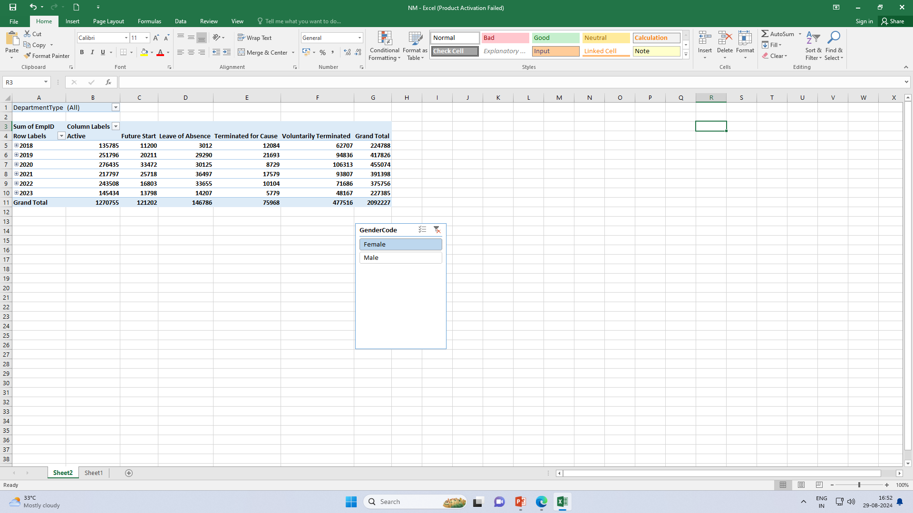
RESULTS

Slide 12
RESULTS
12

Slide 13
conclusion
In conclusion, the salary and compensation analysis through Excel data modeling provides a comprehensive understanding of compensation structures and trends within an organization. By leveraging Excel's powerful data analysis tools, we can identify key patterns and insights, such as salary distribution, compensation disparities, and the impact of various factors like experience, education, and job role on overall pay. This analysis not only helps in making informed decisions regarding pay equity and competitive compensation strategies but also aids in budgeting and forecasting future compensation needs. Ultimately, using Excel for this purpose enables organizations to align their compensation practices with industry standards, improve employee satisfaction, and support strategic HR planning.

